Slide 1

Created By:
Assistant Coordinator of Basic Programming Laboratory
Fasilkom - UDINUS

Slide 2

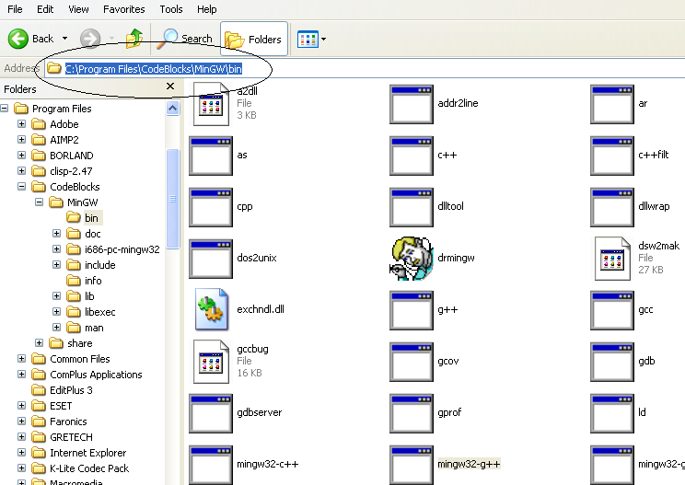
Find directory of gcc path

Slide 3

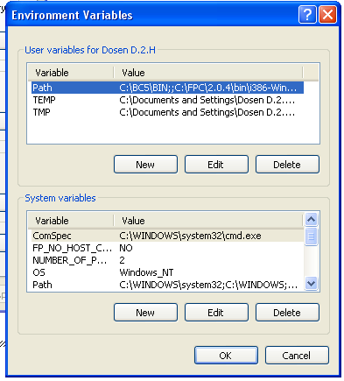
Input gcc path in default windows variable path
Right-click on
my computer->properties
Choose tab advanced
Choose Environment variables

Slide 4

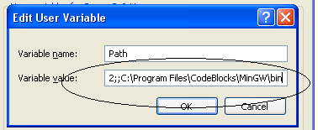
Add value of variable path with gcc path
Use double semicolon to separate (;;)
Example:
Xxxx;; C:\Program Files\CodeBlocks\MinGW\bin

Slide 5

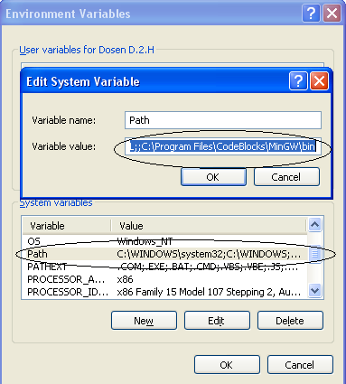
Add value on system variable with path variable’s

Slide 6


